Slide 1
Basics of using ArcGIS Pro
Research Computing Services
February 4, 2020
Dennis Milechin, P.E.
help@scc.bu.edu

Slide 2
Outline
Lecture
What is GIS?
GIS Theory
Geographic coordinate system
Projections
Spatial data types
Attributes
ArcGIS Products
Hands On Portion

Slide 3
What is GIS?
Geographic Information System
“A geographic information system (GIS) is a system designed to capture, store, manipulate, analyze, manage, and present spatial or geographic data”
https://en.wikipedia.org/wiki/Geographic_information_system

Slide 4
GIS Theory – Geographic Coordinate System

Slide 5
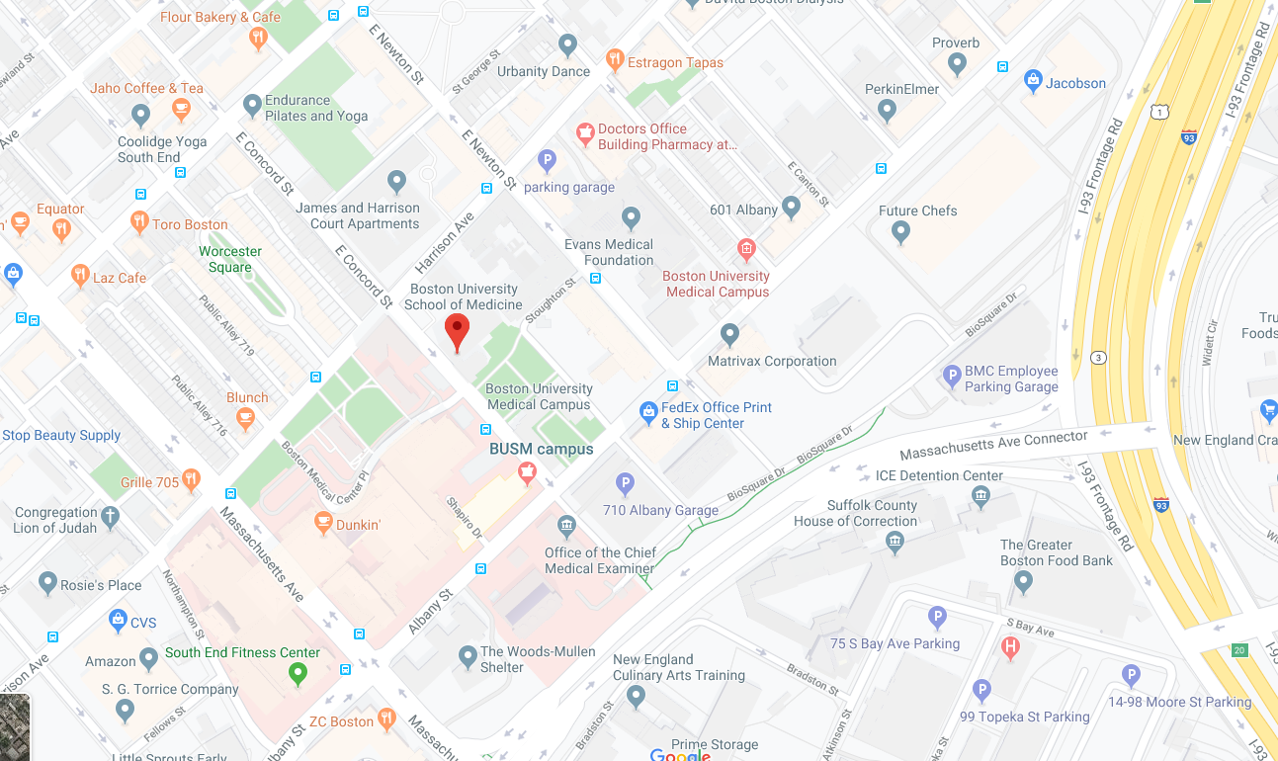
GIS Theory – Geographic Coordinate System
How do I tell a computer where we are located on earth?
We are here!
(42.336046, -71.072484)

Slide 6
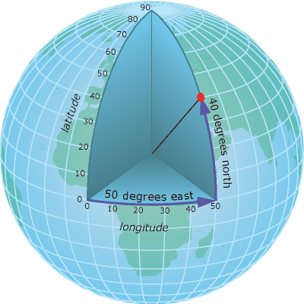
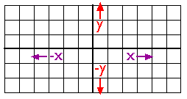
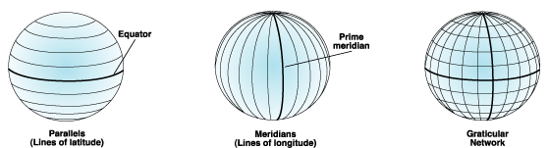
GIS Theory – Geographic Coordinate System
Cartesian Coordinate System
(50 E, 40 N)
Point (2,2)
https://www.e-education.psu.edu/natureofgeoinfo/c2_p10.html
Geographic coordinate system.
http://desktop.arcgis.com/en/arcmap/10.3/guide-books/map-projections/geographic-coordinate-system.htm
Defined by a math model.
http://desktop.arcgis.com/en/arcmap/10.3/guide-books/map-projections/about-geographic-coordinate-systems.htm
http://desktop.arcgis.com/en/arcmap/10.3/guide-books/map-projections/about-geographic-coordinate-systems.htm
Notes:
How much distance does a degree, minute and second cover on your maps?
The distances vary. A degree, minute or second of latitude remains fairly constant from the equator to the poles; however a degree, minute, or second of longitude can vary greatly as one approaches the poles (because of the convergence of the meridians). At 38 degrees North latitude, one degree of latitude equals approximately 364,000 ft (69 miles), one minute equals 6068 ft (1.15 miles), one-second equals 101 ft; one-degree of longitude equals 288,200 ft (54.6 miles), one minute equals 4800 ft (0.91 mile), and one second equals 80 ft.
https://www.usgs.gov/faqs/how-much-distance-does-a-degree-minute-and-second-cover-your-maps?qt-news_science_products=0#qt-news_science_products

Slide 7
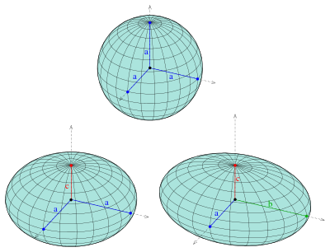
GIS Theory – Geographic Coordinate System
Very complicated topic.
There are many Geographic Coordinate Systems.
There are spherical/ellipsoidal approximation of Earth.
They are updated occasionally.
North American Datum (NAD)
NAD 27
NAD 83 (with 5 updates)
New Datum in 2022!
https://en.wikipedia.org/wiki/Ellipsoid
http://desktop.arcgis.com/en/arcmap/10.3/guide-books/map-projections/about-geographic-coordinate-systems.htm

Slide 8
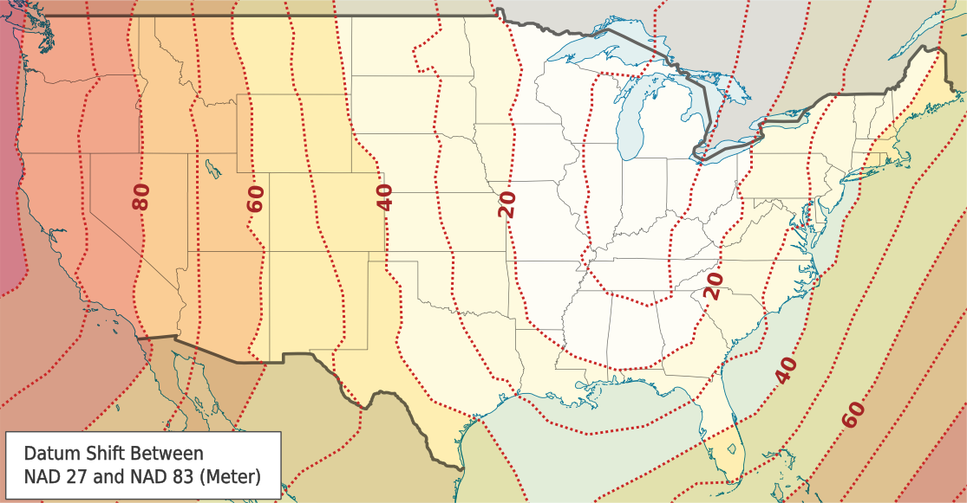
GIS Theory – Geographic Coordinate System
(42.336046, -71.072484)
Could be off by 40 to 45 meters!
https://en.wikipedia.org/wiki/North_American_Datum#/media/File:Datum_Shift_Between_NAD27_and_NAD83.png
http://desktop.arcgis.com/en/arcmap/10.3/guide-books/map-projections/about-geographic-coordinate-systems.htm

Slide 9
GIS Theory –Geographic Coordinate Systems
Geographic Coordinate Systems supported by ArcGIS Pro
https://desktop.arcgis.com/en/arcmap/latest/map/projections/pdf/geographic_coordinate_systems.pdf
http://desktop.arcgis.com/en/arcmap/10.3/guide-books/map-projections/about-geographic-coordinate-systems.htm

Slide 10
GIS Theory – Projections

Slide 11
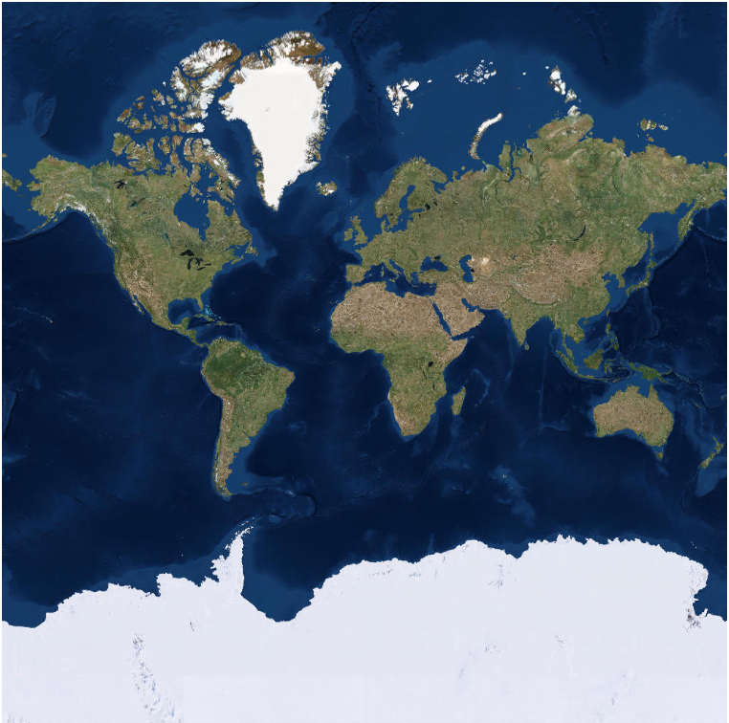
GIS Theory - Projections
Greenland
What is wrong with this map?
Country | Area ( mi ^2)
Africa | 11,730,000
Antarctica | 5,405,000
Greenland | 836,300
Africa
Antarctica

Slide 12
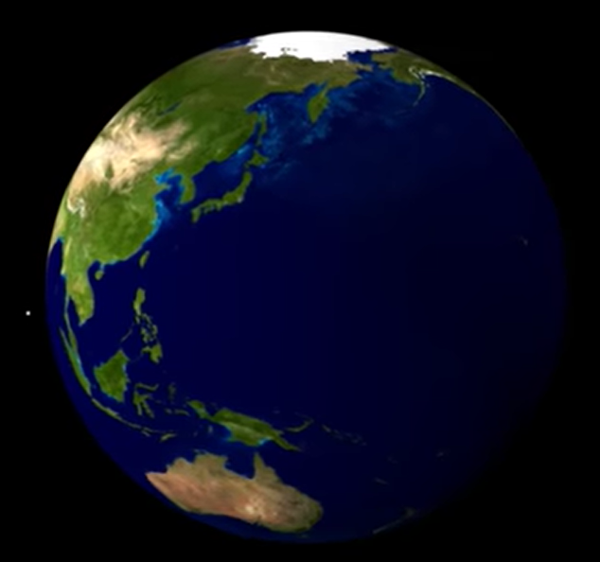
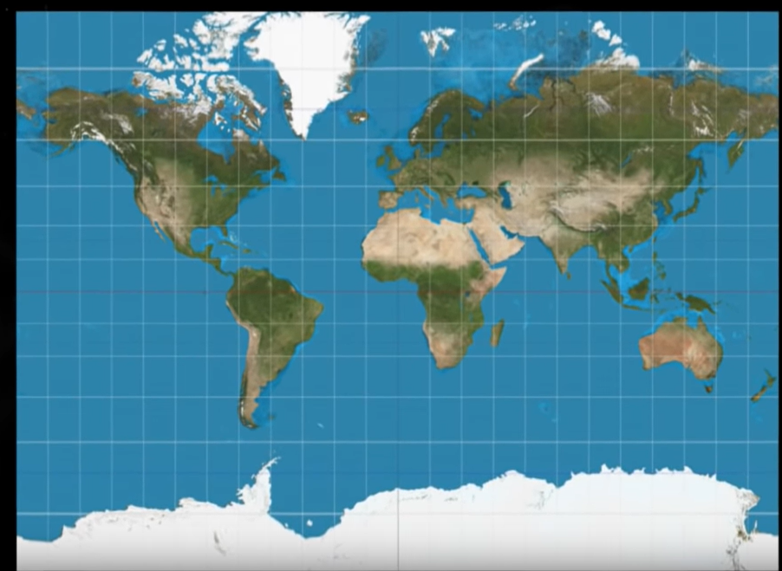
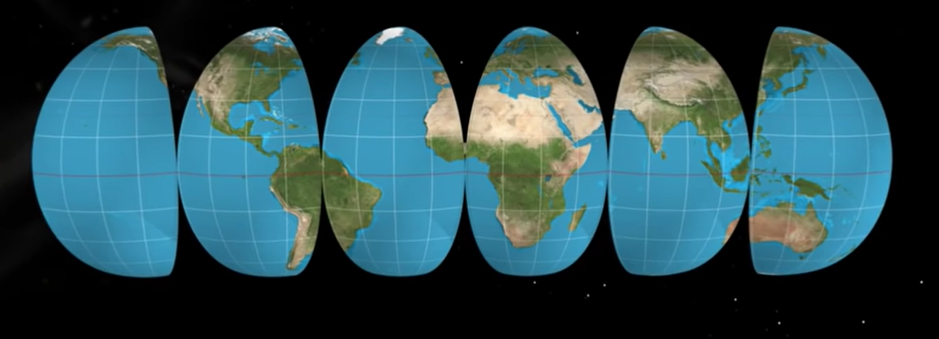
GIS Theory - Projections
https://www.youtube.com/watch?v=CPQZ7NcQ6YQ
https://laughingsquid.com/world-mercator-projection-map-country-size/

Slide 13
GIS Theory - Projections
- Allow creation of flat maps.
- At expense of distorting:
- Shape
- Area
- Direction
- Distance

Slide 14
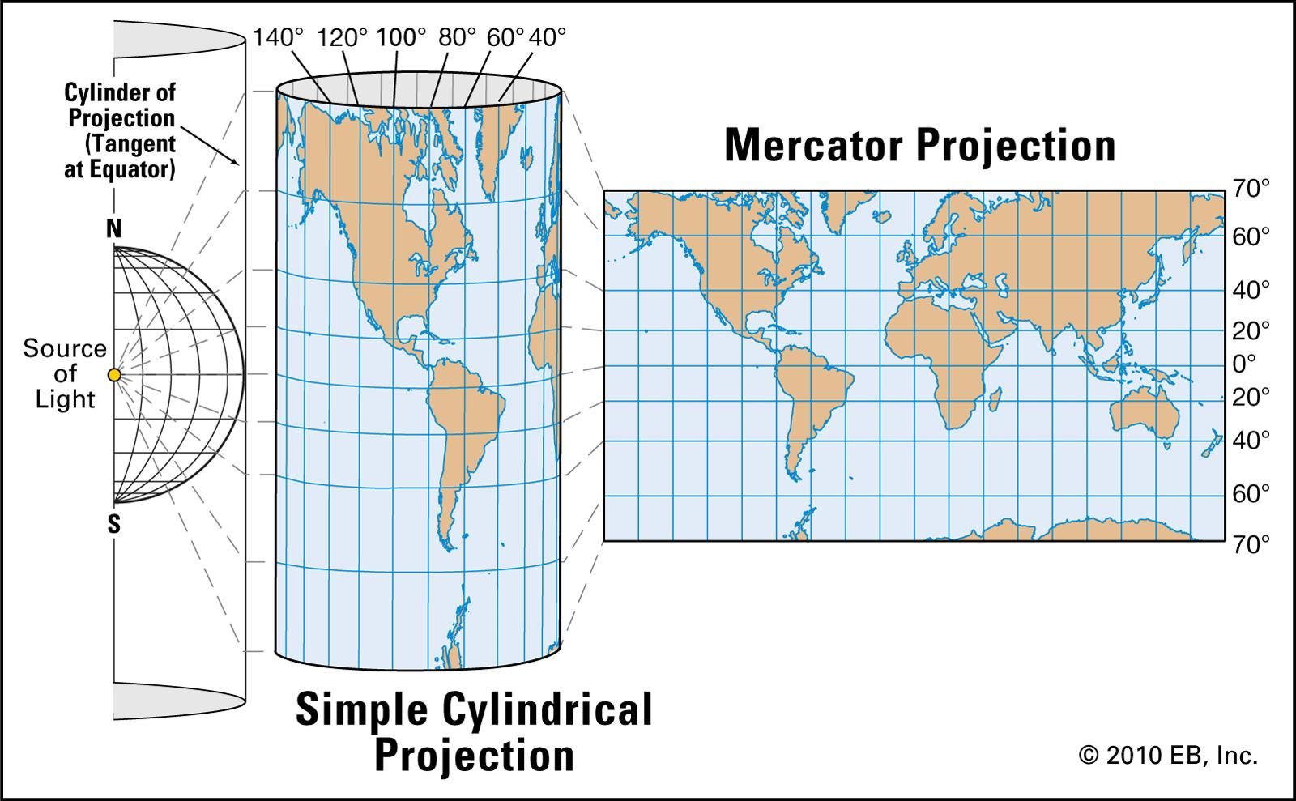
GIS Theory - Projections
Geographic Coordinate System
Projection
http://desktop.arcgis.com/en/arcmap/10.3/guide-books/map-projections/geographic-coordinate-system.htm
https://www.britannica.com/science/Mercator-projection/media/375638/231099

Slide 15
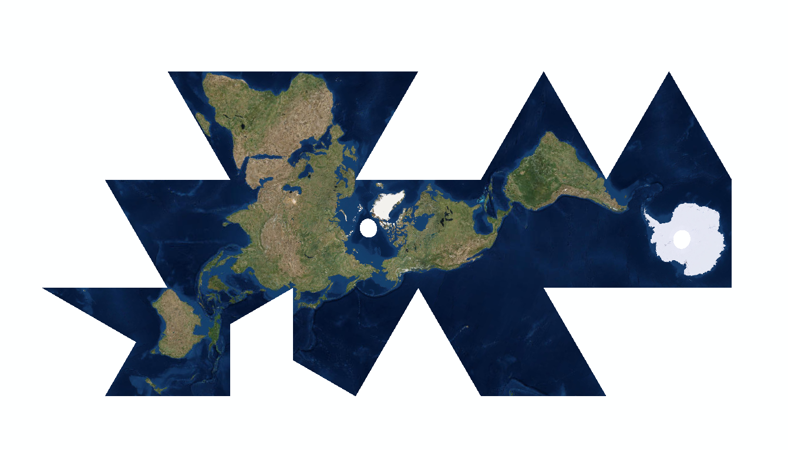

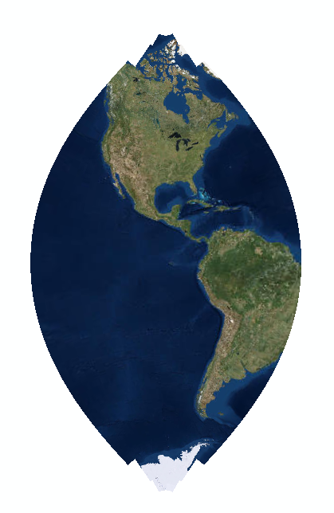
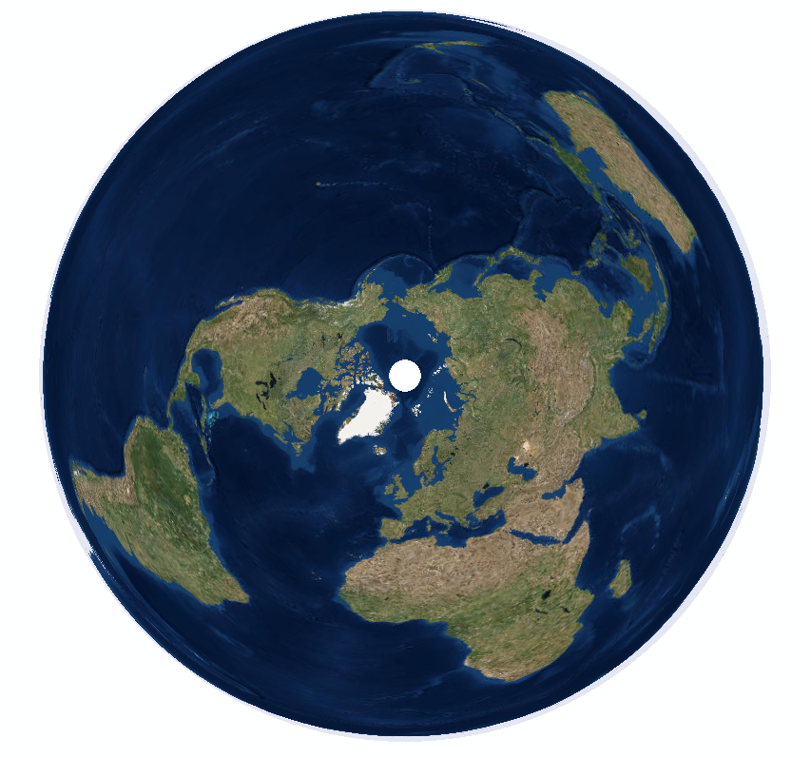
GIS Theory - Projections
World Fuller
Cube World
Polar NSIDC EASE Grid North
NAD 1983 UTM Zone 15N

Slide 16
GIS Theory –Geographic Coordinate Systems
Projected Coordinate Systems supported by ArcGIS Pro
https://desktop.arcgis.com/en/arcmap/latest/map/projections/pdf/projected_coordinate_systems.pdf
http://desktop.arcgis.com/en/arcmap/10.3/guide-books/map-projections/about-geographic-coordinate-systems.htm

Slide 17
GIS Theory
GIS software implements most of the GIS theory for us. Phew!
Why do you need to care?
Certain GIS tools require geographic coordinate system and projection to be the same for all inputs.
Georeferencing images or old maps.
When receiving data, like a CSV file with coordinates, make sure you know the geographic coordinate system and projection!
http://desktop.arcgis.com/en/arcmap/10.3/guide-books/map-projections/about-geographic-coordinate-systems.htm

Slide 18
GIS Theory
Geographic coordinate system and projections.
To learn more:
https://www.e-education.psu.edu/natureofgeoinfo/c2.html

Slide 19
GIS Theory – Spatial Data Types

Slide 20
GIS Theory – Spatial Data types
Spatial
Data Types
Vector
Raster

Slide 21

GIS Theory – Spatial Data Types
Vector
(X, Y)
Points
Polylines
Polygon
Note: Each type of vector data is put in its own group when stored. Example, a Points Shapefile will only have points data, no polylines or polygons.

Slide 22
GIS Theory – Spatial Data types
Spatial
Data Types
Vector
Raster

Slide 23
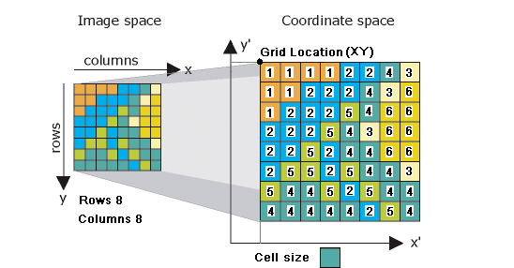
GIS Theory – Spatial Data Types
Raster Data – continuous data
Raster Spatial Properties
Origin
Cell Location
Cell Size
http://desktop.arcgis.com/en/arcmap/latest/manage-data/raster-and-images/what-is-raster-data.htm
http://desktop.arcgis.com/en/arcmap/10.3/manage-data/geodatabases/raster-basics.htm

Slide 24
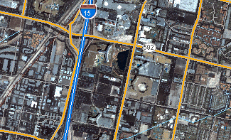
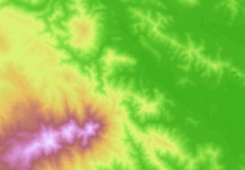
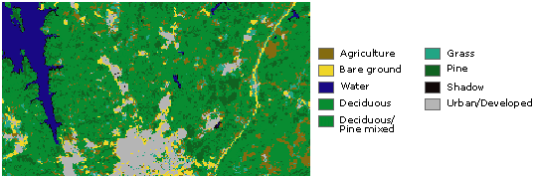
GIS Theory – Spatial Data Types
Examples of Raster Data
http://desktop.arcgis.com/en/arcmap/latest/manage-data/raster-and-images/what-is-raster-data.htm

Slide 25
GIS Theory – Spatial Data Types
Spatial
Component
Raster
Vector
Points
Polylines
Polygon

Slide 26
GIS Theory – Spatial Data Types
How is spatial data stored?
Too many options to cover in this course!
https://pro.arcgis.com/en/pro-app/help/projects/supported-data-types-and-items.htm
Common Ones:
Shapefiles
Geodatabase
CSV Files
Web Map Services

Slide 27
GIS Theory – Attributes

Slide 28
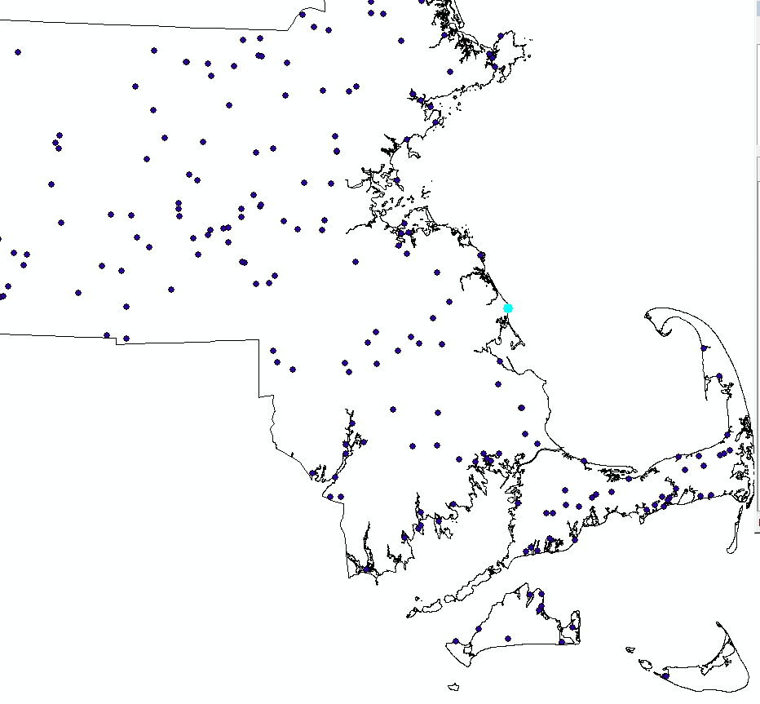
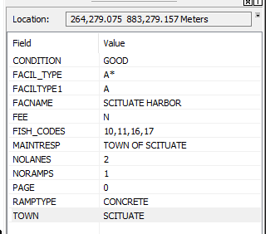
GIS Theory - Attributes
Spatial Component
Attribute Component
(x, y)

Slide 29
ESRI Products

Slide 30
ESRI – Products
Create maps for printing
Symbolize spatial data
Create, edit, delete spatial data
Toolboxes for spatial analysis
- Upload data or maps to ArcGIS Online to share
Desktop Application
ArcGIS Pro
Cloud
ArcGIS Online
ArcGIS StoryMaps
ArcGIS Living Atlas
ArcGIS Hub
ArcGIS Apps
Enterprise Server
ArcGIS Enterprise
Create simple maps
Minimal spatial processing tools
Easy to share maps or spatial data
ESRI managed data repository

Slide 31
ArcGIS Pro
Where can I get ArcGIS Pro?
Works ONLY on Windows
Alternative – QGIS (https://www.qgis.org/)
CAS IT
Free for CAS Students, Faculty, Staff
$125 per year for others.
http://www.bu.edu/casit/information/purchasing-software/
Computer Labs
CAS Building computer labs 327 and 330.
BU Medical – “L” Building L1110

Slide 32
ArcGIS Online
Where can I get ArcGIS Online access?
CAS IT can create an account for you
http://www.bu.edu/casit/help-request/

Slide 33
ArcGIS Pro

Slide 34
ArcGIS Pro – Example Workflow
Collect field data with coordinates, or download it.
https://www.mass.gov/service-details/massgis-data-layers
Clean the data
Import data into ArcGIS Pro.
Use ArcGIS Pro to visualize the data in map form.
Use Toolboxes to do spatial analysis.
Create map showing the results.
Share the map/results with others.
This Tutorial

Slide 35
ArcGIS Pro - Resources
Introducing ArcGIS Pro
https://pro.arcgis.com/en/pro-app/get-started/introducing-arcgis-pro.htm
Help Documentation
https://pro.arcgis.com/en/pro-app/help/main/welcome-to-the-arcgis-pro-app-help.htm
ArcGIS Pro Tool Reference
https://pro.arcgis.com/en/pro-app/tool-reference/main/arcgis-pro-tool-reference.htm
ArcGIS Pro Python Reference
https://pro.arcgis.com/en/pro-app/arcpy/main/arcgis-pro-arcpy-reference.htm
Lesson Galleries of specific applications of GIS
https://learn.arcgis.com/en/gallery/

Slide 36
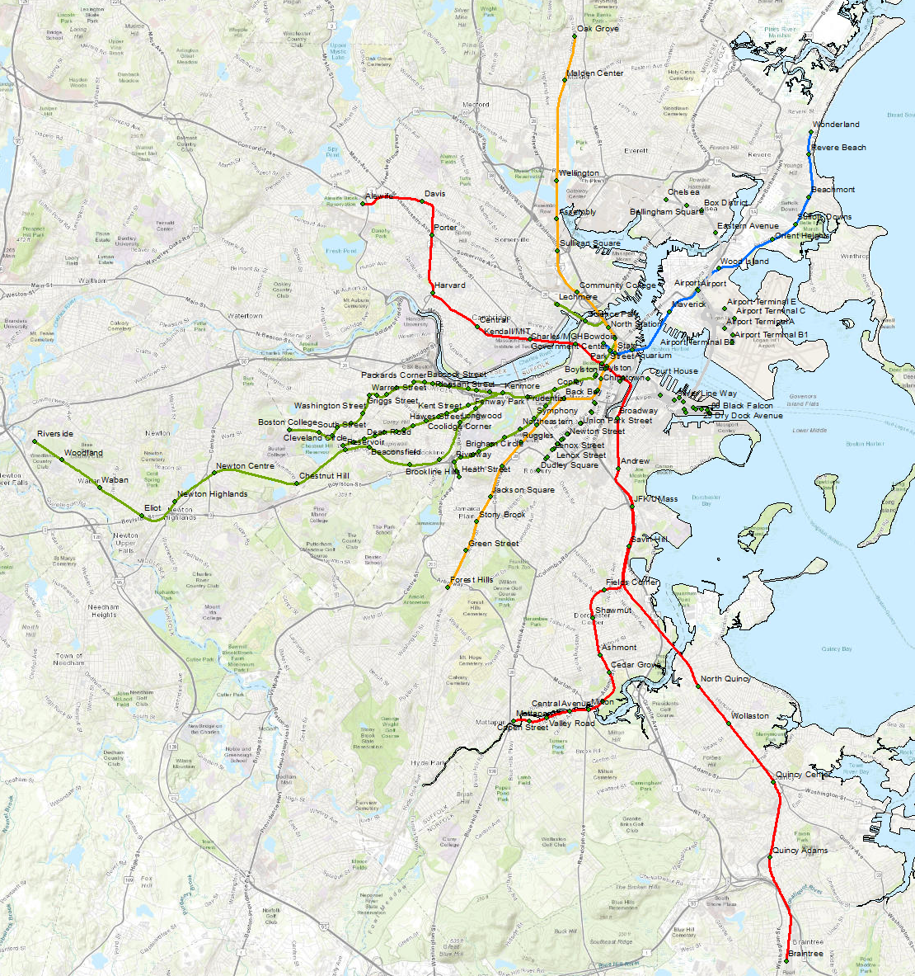
Let’s Open ArcGIS Pro!

